Slide 1
IMPLEMENTAION OF REINFORCEMENT LEARNING AGENT ON A SNAKE GAME
TEAM –
Naveen Kumar Reddy. D (00770540)
Likhita Chandana Adabala(00759897)

Slide 2
IMPLEMENTAION OF A REINFORCEMENT LEARNING AGENT ON A SNAKE GAME
PROJECT OBJECTIVE :
We use the reinforcement learning mechanism on an existing video game (snake game).
Here, The goal is to create a Reinforcement Learning agent to make an optimal decision in the closed environment to get the highest reward.
In this environment, it has incomplete information, and the state space of agents are quite large, We need to deal with these hurdles.
The snake game starts with a dot, the main aim is to collect more dots and goes on increasing the size.
It moves with one dot at a time that is either left, right or straight and the game ends when the snake collides with it’s own body or with the edge(wall)

Slide 3
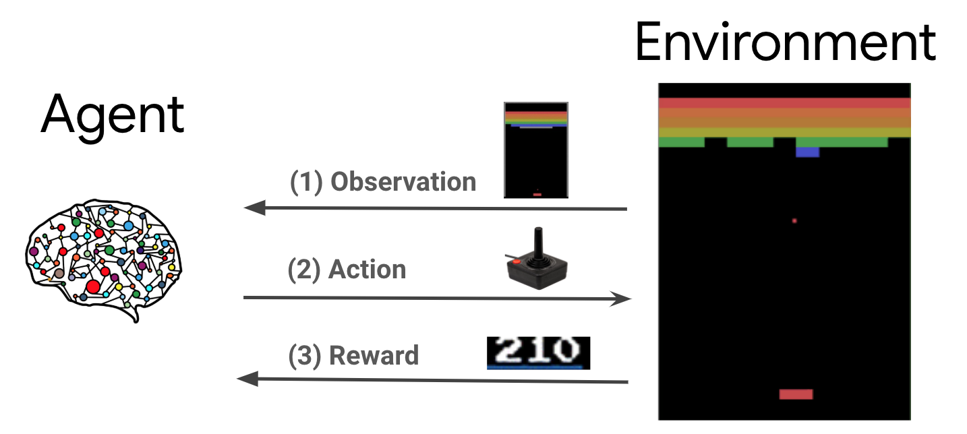
What is an RL agent?

Slide 4



APPROACH:
TOOLS :
Pytorch - Its a widely used open-source machine learning framework used for various applications, developed by the Facebook AI research team.
Numpy - It is a library for python programming language, which is used to perform large variety of mathematical functions to operate on array. It frees up the memory faster so that the overall task executes faster.
Pygame - It is an open-source cross platform library intended for writing video games and other multimedia applications. It can run on various operating systems and platforms.

Slide 5

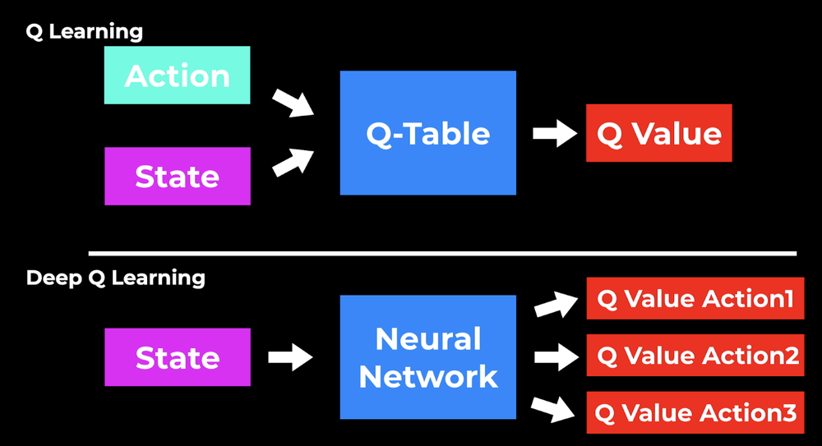
TECHNIQUES:
DEEP Q-LEARNING -
It is RL algorithm to understand the action in every state. We use the deep q-learning technique to allow our agent to perform optimal decisions from input data.
It is an algorithm in which we tune the hyper parameters of Q-learning algorithm using multiple layers of neural networks.
ARTIFICIAL NEURAL NETWORK -
It is a simple neural network i.e; interconnected group of nodes inspired from the neurons in brain.
We create an input layer, which defines the current state of the snake, a hidden layer with nodes and an output layer to determine action to take.

Slide 6
Prerequisites before starting the project
Obstacles
Obstacles: The environment has incomplete information and the state space of the agent are extremely large.
Environment and State Space: Environment consists of n*n matrix with width and height. Where the snake game will be displayed.
Action space: This represents the directions in which the snake can move { Left, Right, Up, Down}
Rewards: They can be positive and negative. While making each move towards food or away from it or either collision with wall or itself will be counted as positive or negative reward.
Environment and state space
Action Space
Rewards

Slide 7
Parameters to consider for optimization of agents
For maximizing immediate rewards: Gamma
A balance of both exploration and exploitation : Epsilon
Learning rate of snake agent
Reward for food eating
Collision to wall: Negative Rewards
Collision to self : Negative rewards
Snake going on a loop

Slide 8
Performance metrics
By changing the values for the parameters, we can compare the performance of our RL AGENT with the default values and by changing each reward at a particular phase.
For example , the parameters effect the behavior of agent like not mentoring about the state space without any directions and also the state space contains only walls information but not any direction
All these factors can influence the performance of our RL agent.
In the next slide, there is a detailed picturization in the form of graph of how the proper state space is mentioned vs. changing the parameters.

Slide 9
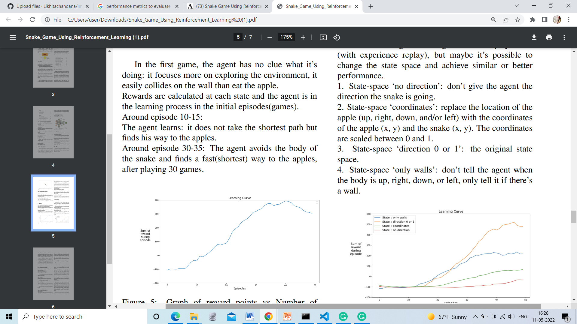
OUTPUTS OF PARAMETERS WITH DETAITED STATE SPACE VS CHANGED VALUES

Slide 10
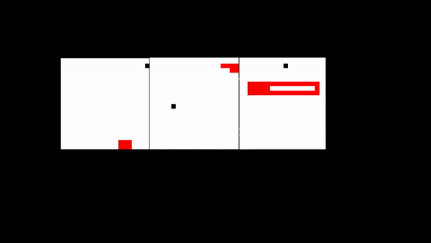
SNAKE GAME SAMPLE DEPLOYMENT

Slide 11
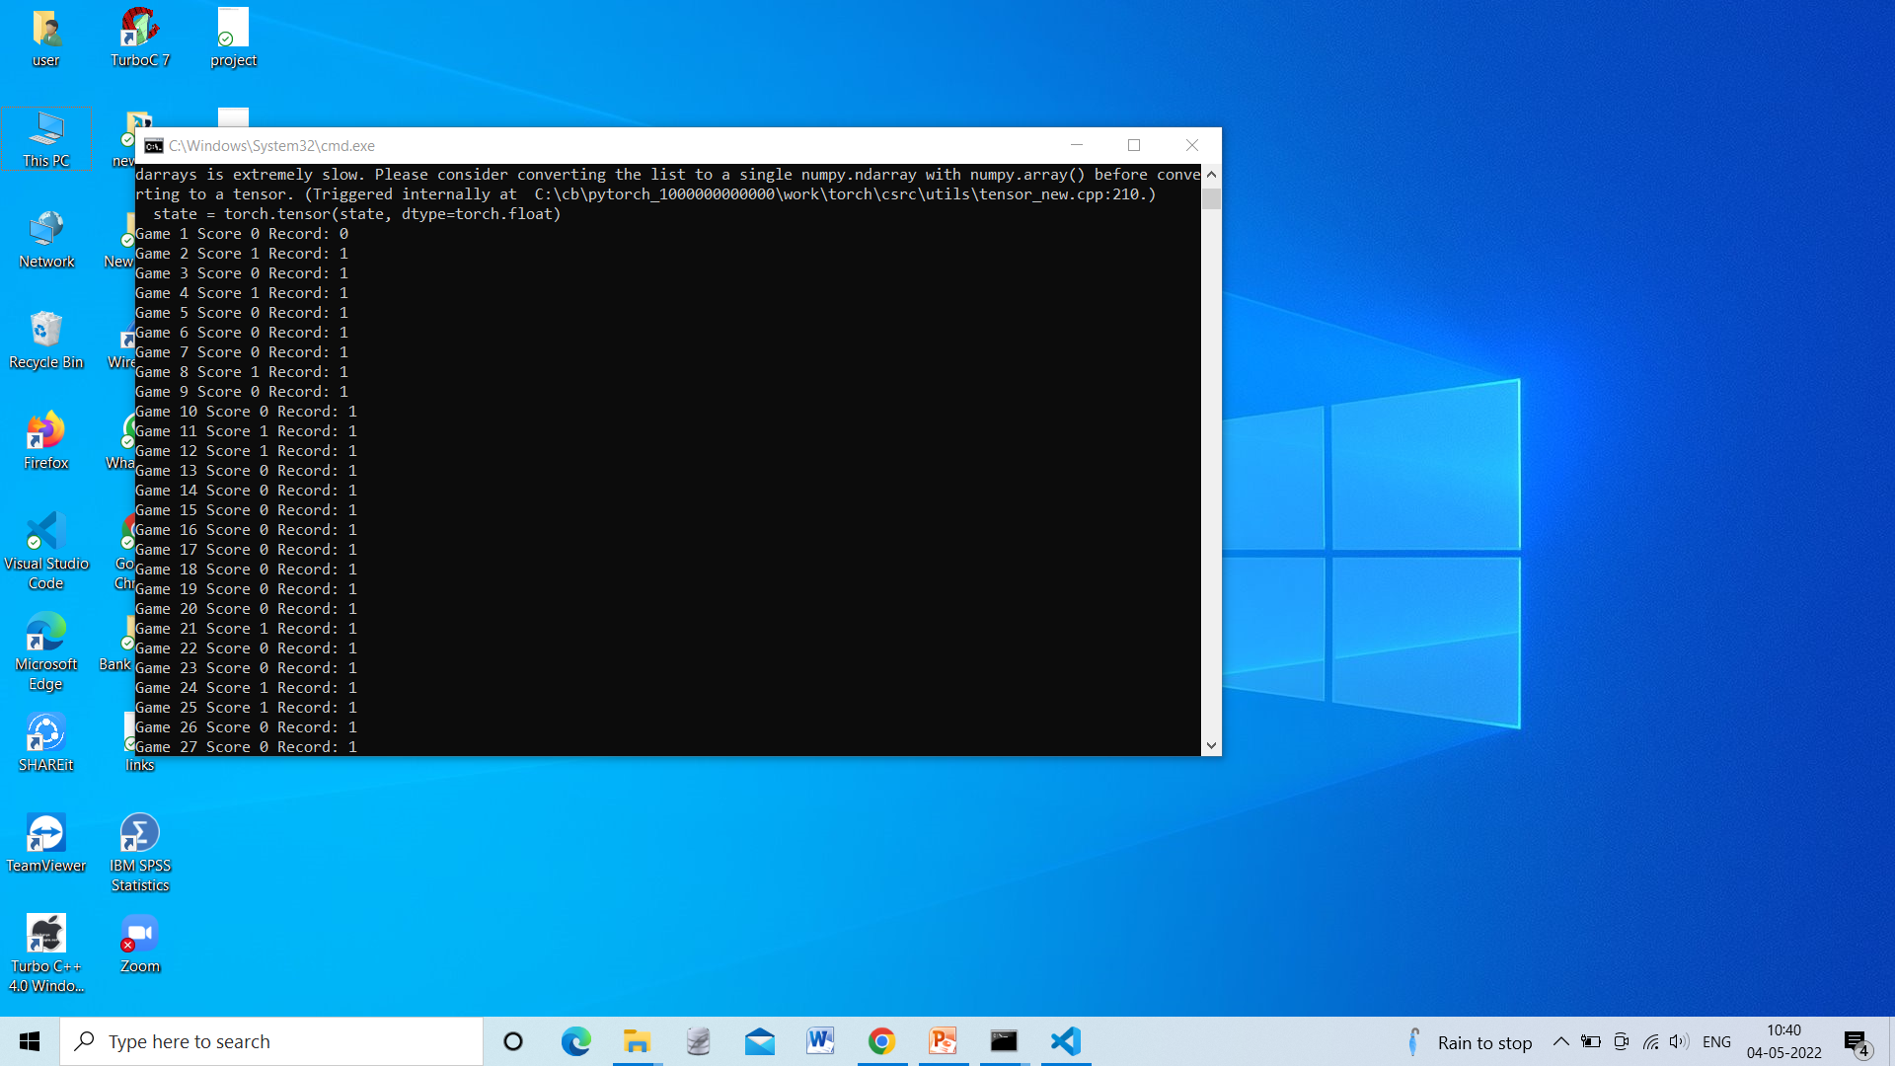
Output of the Game

Slide 12
CONCLUSION
Based on the parameter values we have chosen. We found to see how the agent would perform over a 1000 games compared with the default values we have taken. These experiments are conducted to find the optimal values to make our RL agent more efficient than that of default values.
Learning rate, epsilon and gamma parameters had the biggest impact on the performance.
The other parameters like food distance, direction and food generation were detrimental to the experiment

Slide 13
DELIVERABLES:
User documentation manual which gives details about the snake game implementation using reinforcement learning.
Algorithms developed for reinforcement learning agent using python programming.
GitHub repository link for project code and other related files.
YouTube video demonstrating project implementation through PowerPoint presentation.

Slide 14
THANK YOU
Naveen kumar Reddy D
Likhita Chandana Adabala

